Slide 1
Graphing direct proportion
Understanding multiplicative relationships: percentages and proportionality

Slide 2
how to use Oak lessons

Slide 3
I can recognise direct proportion graphically and be able to identify features of the graph.

Slide 4
Two variables are in direct proportion if they have a constant multiplicative relationship.

Slide 5

Graphing direct proportion
Features of graphs
Graphs representing direct proportion

Slide 6
Features of graphs
We know that we can show any variables which are in direct proportion on a graph. We have seen this previously when looking at conversions, costs etc.
In this lesson we are going to concentrate on what the key features of a graph showing direct proportion are.
Before we do that we will use a ratio table to check whether variables are proportional to each other.

Slide 7
Features of graphs
If two variables have a constant multiplicative relationship, they are in direct proportion.
We will consider if A and B are directly proportional to each other.
A | B
3 | 12
15 | 60
A | B
6 | 15
7 | 21
× 2.5
× 5
× 5
× 3
The multiplicative relationship is constant. Therefore, A and B are directly proportional to each other.
The multiplicative relationship is not constant. Therefore, A and B are not directly proportional to each other.

Slide 8

Features of graphs
Sort the following into examples and non-examples of tables showing direct proportion.
A | B
12 | 96
6 | 48
A | B
7 | 73.5
35 | 352.8
A | B
16 | 12.8
9 | 7.2
a
b
c
example
non-example
example

Slide 9
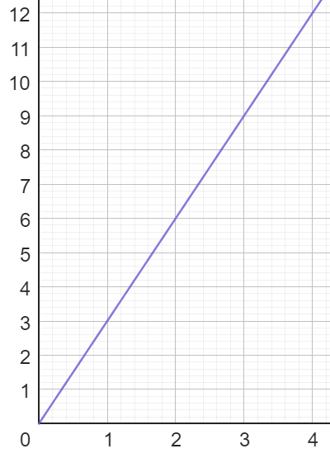
Features of graphs
A box of pens costs £3
The number of boxes and cost are directly proportional.
Cost (£)
This graph represents this directly proportional relationship.
Boxes

Slide 10
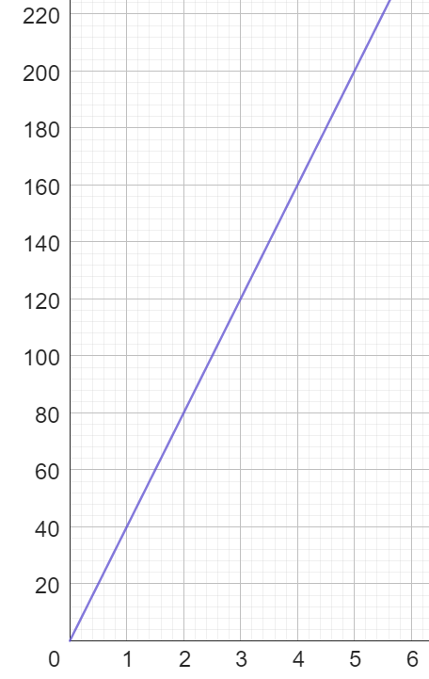
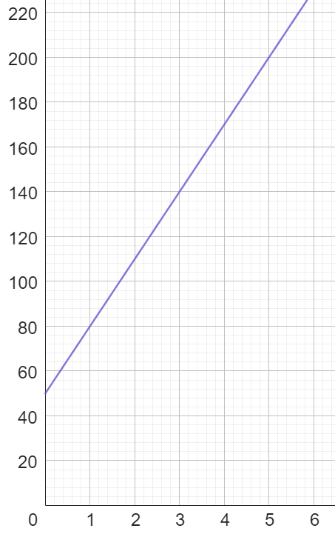
Features of graphs
Plumber A charges £40 per hour.
Plumber B charges a £50 call out charge plus £30 per hour.
Are the number of hours and charge directly proportional?
Let’s take a look at the graphs.
Charge (£)
Charge (£)
Plumber A
Plumber B
Hours
Hours

Slide 11
Features of graphs
Charge (£)
Does this graph show direct proportion?
Let’s check using our method.
Plumber A
× 2
1 hour = £40
× 2
2 hours = £80
Plumber A’s charge is directly proportional to the number of hours.
Hours

Slide 12
Features of graphs
Charge (£)
Does this graph show direct proportion?
Let’s check using our method.
Plumber B
× 2
1 hour = £80
× 1.375
2 hours = £110
Plumber B’s charge is not directly proportional to the number of hours.
Hours

Slide 13
Features of graphs
What is the same and what is different about these graphs?
Charge (£)
Charge (£)
Plumber A
Plumber B
This graph shows direct proportion.
This graph does not show direct proportion.
Hours
Hours
They both have a constant positive gradient.
The one on the left starts at the origin and the one on the right doesn’t.

Slide 14
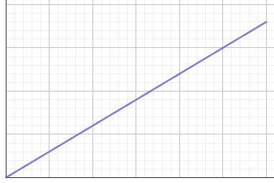
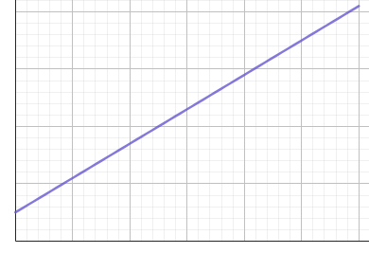
Features of graphs
Graphs showing direct proportion have a constant positive gradient with an intercept of 0
a constant positive gradient and intercept of zero
a constant positive gradient and intercept of 0.5
example of graph showing direct proportion
non-example of graph showing direct proportion

Slide 15
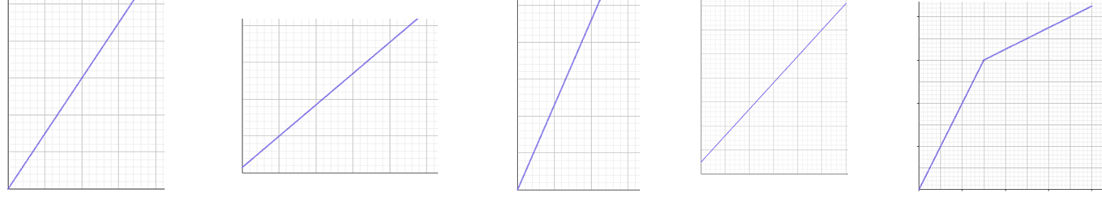
Features of graphs
Sort the following into examples and non-examples of graphs showing direct proportion.
a
b
c
d
e
example
non-example
example
non-example
non-example

Slide 16
Features of graphs
1) Which of the following tables show that A and B are in direct proportion? Give a reason for your answers.
a) c)
b) d)
A | B
3 | 96
12 | 384
A | B
152 | 60.8
6 | 1.8
A | B
16 | 12
4 | 2.9
A | B
17 | 30.6
45 | 81

Slide 17

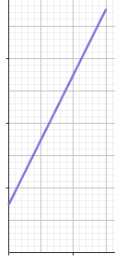
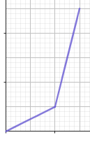
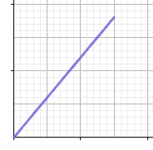
Features of graphs
2) Which of the following graphs show two variables that are in direct proportion? Give a reason for your answers.
a) c)
b) d)

Slide 18



Features of graphs
1) Which of the following tables show that A and B are in direct proportion? Give a reason for your answers.
a) c)
b) d)
A | B
3 | 96
12 | 384
A | B
152 | 60.8
6 | 1.8
× 0.4
× 4
× 4
× 0.3
A | B
16 | 12
4 | 2.9
A | B
17 | 30.6
45 | 81
× 1.8
× 0.25
or
÷ 4
×
× 1.8

Slide 19
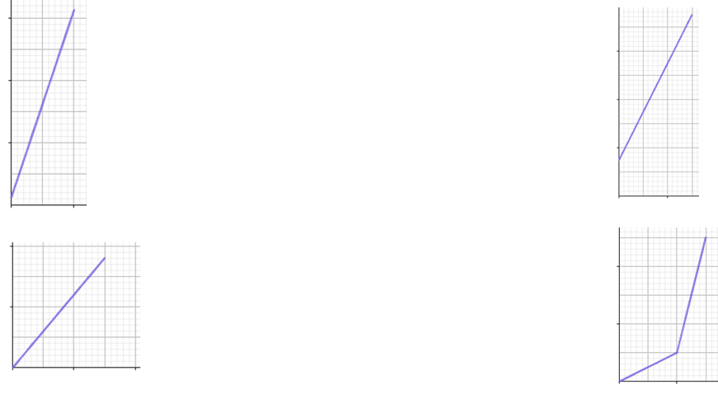
Features of graphs
2) Which of the following graphs show two variables that are in direct proportion? Give a reason for your answers.
a) c)
b) d)
It has a constant positive gradient but the intercept is not zero.
It has a constant positive gradient but the intercept is not zero.
It has a constant positive gradient and the intercept is zero.
The intercept is zero but the gradient is not constant.

Slide 20
Graphing direct proportion
Features of graphs
Graphs representing direct proportion

Slide 21
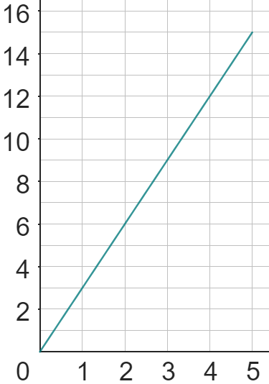
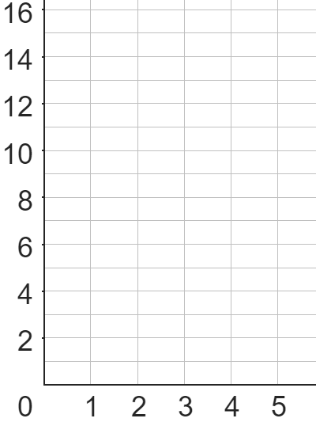
Graphs representing direct proportion
The table below shows two variables x and y.
Are they directly proportional?
What is the multiplicative relationship between x and y?
y = 3 × x
x | y
0 | 0
1 | 3
2 | 6
3 | 9
4 | 12
5 | 15
y
What is the gradient of the line?
x
Let’s plot the graph that represents this relationship.
x
The gradient of the line is 3
What do you notice?
The multiplicative relationship is the same as the gradient.
x
+3
x
+1
x
× 3
x
x

Slide 22


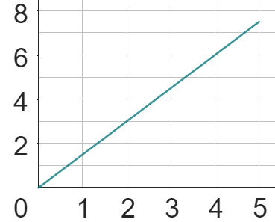
Graphs representing direct proportion
I wonder if the multiplicative relationship between x and y is always the same as the gradient?
x | y
0 | 0
2 | 3
4 | 6
6 | 9
8 | 12
10 | 15
Jun
What do you think?
y
Change in x | Change in y
2 | 3
1 | 1.5
Change in x | Change in y
2 | 3
1
Change in x | Change in y
2 | 3
+3
× 1.5
+2
Yes, the gradient is the same as the multiplicative relationship.
x

Slide 23
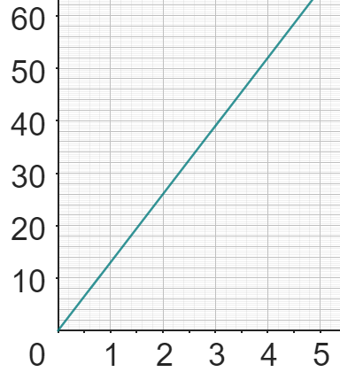
Graphs representing direct proportion
Below is a graph showing the relationship between number of cookies and amount of chocolate chips.
What is the multiplicative relationship between them?
Change in cookies | Change in choc chips (g)
2 | 26
Change in cookies | Change in choc chips (g)
2 | 26
1
chocolate chips (g)
Change in cookies | Change in choc chips (g)
2 | 26
1 | 13
x
(4, 52)
+26
The multiplicative relationship between the number of cookies and the amount of chocolate chips is: number of cookies × 13 = grams of choc. chips
(2, 26)
x
+2
cookies

Slide 24
Graphs representing direct proportion
We know that graphs showing direct proportion have a constant positive gradient and an intercept of zero.
This means that they can all be written as an equation in the form: y = kx (where k is the constant of proportionality)
The constant of proportionality is:
the multiplicative relationship between the two variables
the rate of change
the gradient

Slide 25
Graphs representing direct proportion
Let’s take a look at the graphs we looked at earlier.
y
x
The multiplicative relationship between x and y is: y = 3x
The rate of change in y as x increases by 1 is 3
The gradient of the line is 3
The constant of proportionality is 3
The equation of this line is y = 3x
x
x
+3
x
+1
x
x
x

Slide 26
Graphs representing direct proportion
y
The multiplicative relationship between x and y is: y = 1.5x
The rate of change in y as x increases by 1 is 1.5
The gradient of the line is 1.5
The constant of proportionality is 1.5
The equation of this line is y = 1.5x
+3
+2
x
Change in x | Change in y
2 | 3
1 | 1.5

Slide 27
Graphs representing direct proportion
The multiplicative relationship between x and y is: y = 13x
The rate of change in y as x increases by 1 is 13
The gradient of the line is 13
The constant of proportionality is 13
The equation of this line is
y = 13x
chocolate chips (g)
x
(4, 52)
+26
(2, 26)
x
+2
cookies
Change in cookies | Change in choc chips (g)
2 | 26
1 | 13

Slide 28
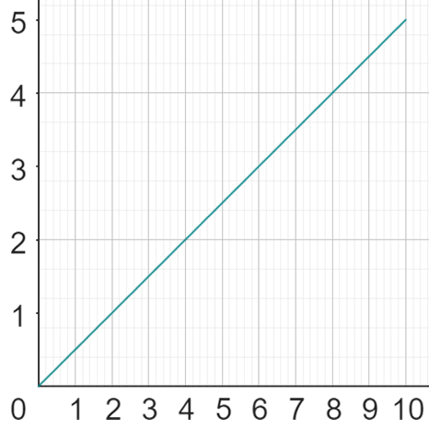
Graphs representing direct proportion
Complete the following:
b
The _____ relationship between a and b is: b = .
The rate of change in b as a ____ by 1 is .
The __ .of the line is .
The __.of proportionality is ___
The equation of this line is .
x
(8, 4)
+2
(4, 2)
x
+4
a
Change in a | Change in b

Slide 29
Graphs representing direct proportion
Complete the following:
b
The _____ relationship between a and b is: b = .
The rate of change in b as a ____ by 1 is .
The __ .of the line is .
The __.of proportionality is ___
The equation of this line is .
multiplicative
x
(8, 4)
0.5a
+2
increases
(4, 2)
0.5
x
+4
gradient
0.5
a
constant
0.5
b = 0.5a
Change in a | Change in b
Change in a | Change in b
4 | 2
1 | 0.5

Slide 30
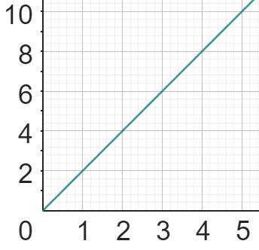
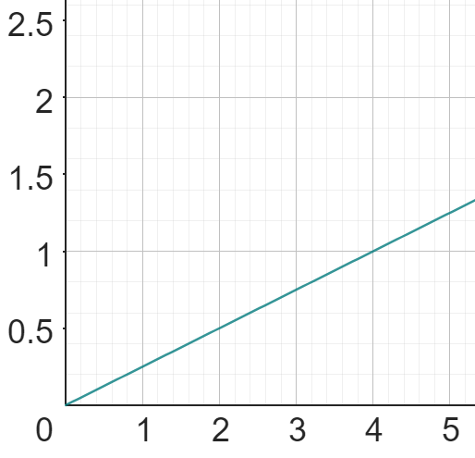
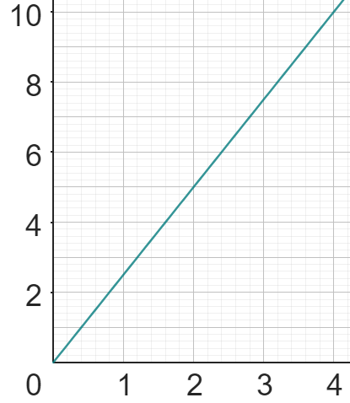
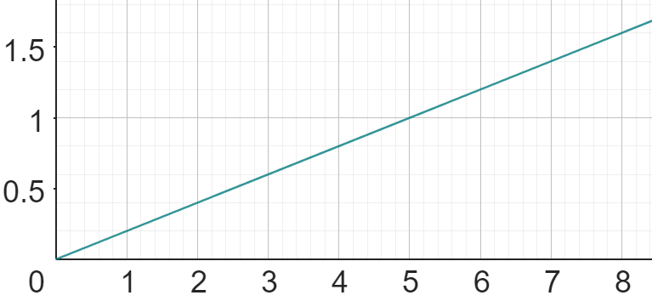
Graphs representing direct proportion
1) Calculate the value of k (constant of proportionality) from the following graphs:
a) c)
b) d)
y
y
x
k = .
x
k = .
y
y
x
x
k = .
k = .

Slide 31
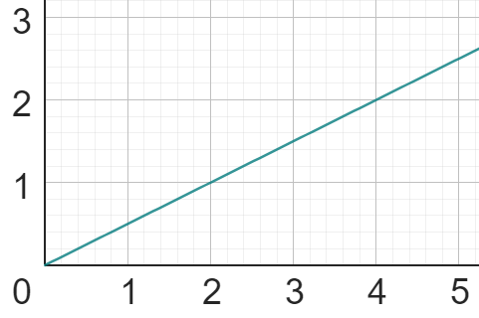
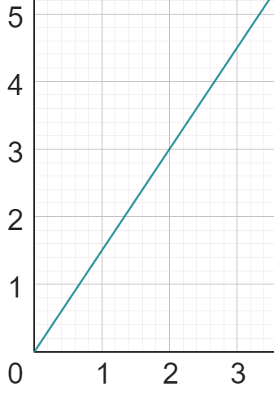
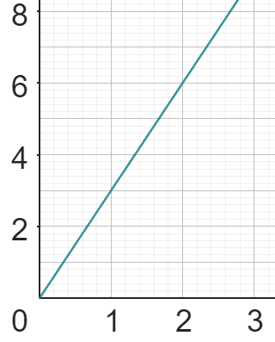
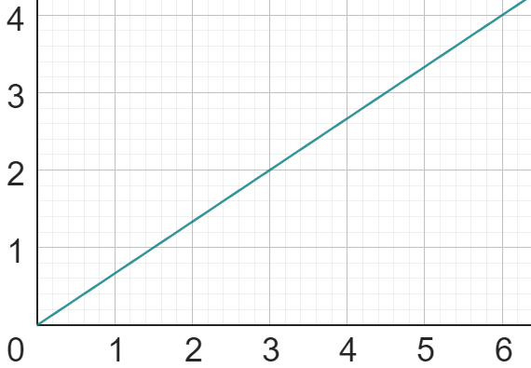
Graphs representing direct proportion
2) Match each table, equation and graph.
a)
A
C
x | 0 | 2 | 4 | 6 | 8
y | 0 | 3 | 6 | 9 | 12
i)
y = 3x
b)
x | 0 | 1 | 4 | 7 | 10
y | 0 | 3 | 12 | 21 | 30
y = 0.5x
ii)
c)
x | 0 | 6 | 18 | 24 | 30
y | 0 | 4 | 12 | 16 | 20
y = 1.5x
iii)
B
D
d)
x | 0 | 2 | 8 | 12 | 18
y | 0 | 1 | 4 | 6 | 9
y = x
iv)

Slide 32
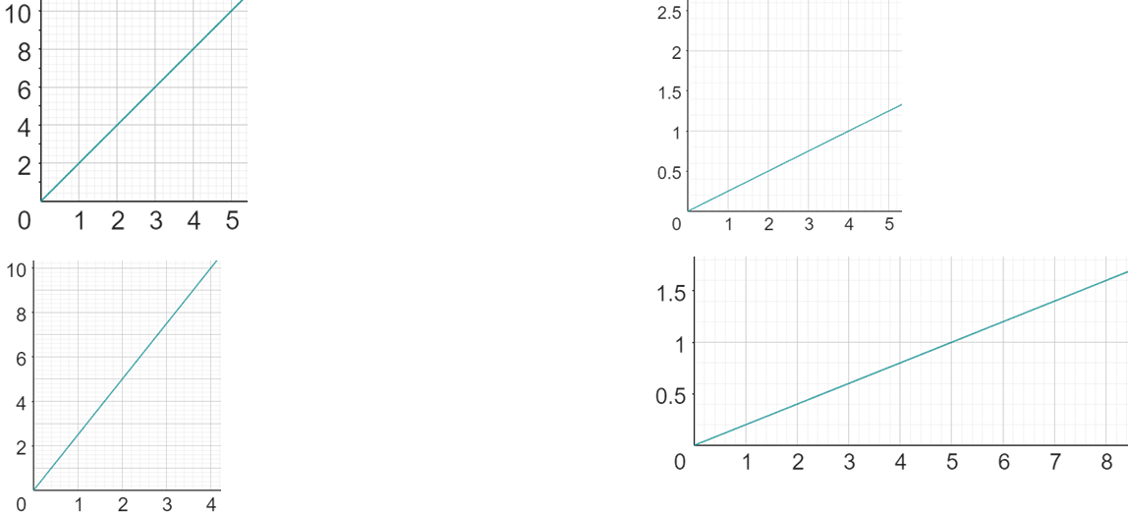

Graphs representing direct proportion
1) Calculate the value of k (constant of proportionality) from the following graphs:
a) c)
b) d)
y
y
+2
k = 1 ÷ 4
= 0.25 or
+1
+4
+1
x
k = 2
x
y
y
+6
+0.6
+3
+2.4
k = 6 ÷ 2.4
= 2.5
k = 0.6 ÷ 3
= 0.2
x
x

Slide 33
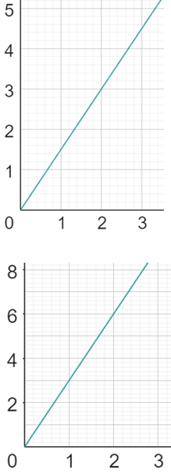
Graphs representing direct proportion
2) Match each table, equation and graph.
a)
C
y = 1.5x
x | 0 | 2 | 4 | 6 | 8
y | 0 | 3 | 6 | 9 | 12
iii)
b)
x | 0 | 1 | 4 | 7 | 10
y | 0 | 3 | 12 | 21 | 30
i)
y = 3x
D

Slide 34
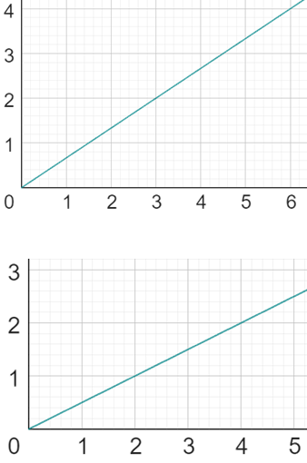
Graphs representing direct proportion
2) Match each table, equation and graph.
c)
B
iv)
y = x
x | 0 | 6 | 18 | 24 | 30
y | 0 | 4 | 12 | 16 | 20
d)
x | 0 | 2 | 8 | 12 | 18
y | 0 | 1 | 4 | 6 | 9
ii)
y = 0.5x
A

Slide 35
Graphing direct proportion
The key features of a graph showing direct proportion are:
it has a constant positive gradient
the origin is the y-intercept
This means that they can all be written as an equation in the form: y = kx (where k is the constant of proportionality)
The constant of proportionality is:
the multiplicative relationship between the two variables
the rate of change
the gradient

Slide 36

© Oak National Academy 2024.
Produced in partnership with Mathematics in Education and Industry.
Licensed on the Open Government Licence v3.0, except where otherwise stated. See Oak terms and conditions.

